Slide 1
Embedded Software: Device Drivers
Embedded Operating Systems

Slide 2
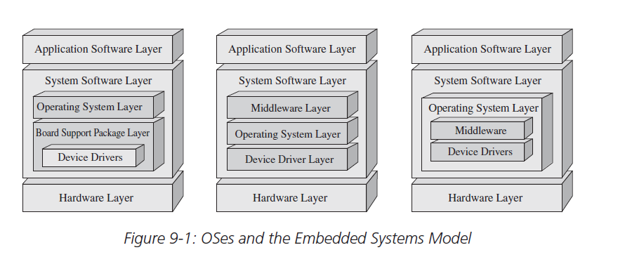
Operating System
An operating system (OS) is an optional part of an embedded device’s system software stack, meaning that not all embedded systems have one
OSes can be used on any processor (ISA) to which the OS has been ported

Slide 3
Cont’d
The OS is a set of software libraries that serves two main purposes in an embedded system:
Providing an abstraction layer for software on top of the OS to be less dependent on hardware, making the development of middleware and applications that sit on top of the OS
Easier, and managing the various system hardware and software resources to ensure the entire system operates efficiently and reliably
While embedded OSes vary in what components they possess, all OSes have a kernel at the very least
The kernel is a component that contains the main functionality of the OS, specifically all or some combination of features and their interdependencies,

Slide 4
Cont’d
Process Management:
A sub function typically found within process management is interrupt and error detection management
The multiple interrupts and/or traps generated by the various processes need to be managed efficiently so that they are handled correctly and the processes that triggered them are properly tracked
Memory Management:
The embedded system’s memory space is shared by all the different processes, so access and allocation of portions of the memory space need to be managed
Within memory management, other sub functions such as security system management allow for portions of the embedded system sensitive to disruptions that can result in the disabling of the system, to remain secure from unfriendly, or badly written, higher-layer software

Slide 5
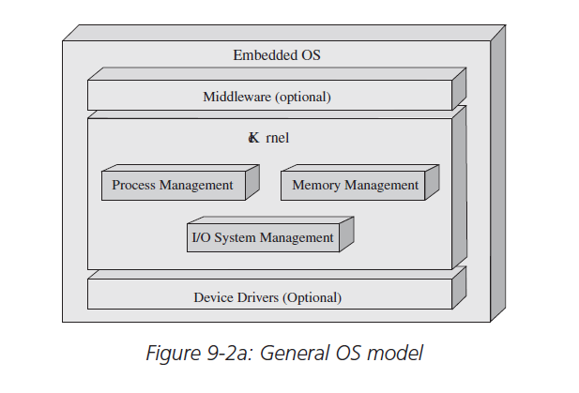
Cont’d
I/O System Management:
I/O devices also need to be shared among the various processes and so, just as with memory, access and allocation of an I/O device need to be managed
Through I/O system management, file system management can also be provided as a method of storing and managing data in the forms of files

Slide 6
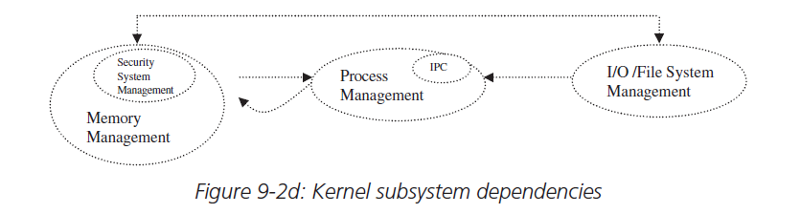
Cont’d

Slide 7
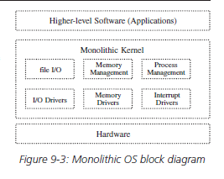
Types of embedded operating system
Types:
Monolithic OS
Layered OS
Microkernel OS
In a monolithic OS, middleware and device driver functionality is typically integrated into the OS along with the kernel
This type of OS is a single executable file containing all of these components
Monolithic OSes are usually more difficult to scale down, modify, or debug than their other OS architecture counterparts, because of their inherently large, integrated, cross-dependent nature

Slide 8
Cont’d
In the layered design, the OS is divided into hierarchical layers (0...N), where upper layers are dependent on the functionality provided by the lower layers
Like the monolithic design, layered OSes are a single large file that includes device drivers and middleware
While the layered OS can be simpler to develop and maintain than a monolithic design, the APIs provided at each layer create additional overhead that can impact size and performance
For example: DOS-C(FreeDOS), DOS/eRTOS, and VRTX are all examples of a layered OS.

Slide 9
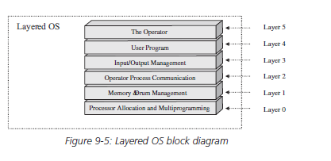
Cont’d

Slide 10
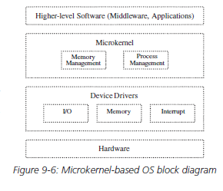
Cont’d
The microkernel OS is typically a more scalable (modular) and debuggable design, since additional components can be dynamically added in
It is also more secure since much of the functionality is now independent of the OS, and there is a separate memory space for client and server functionality
It is also easier to port to new architectures
However, this model may be slower than other OS architectures, such as the monolithic, because of the communication paradigm between the microkernel components and other “kernel-like” components

Slide 11
Process
OSes manage an embedded device’s hardware and software resources, the reader must first understand how an OS views the system
An OS differentiates between a program and the executing of a program
A program is simply a passive, static sequence of instructions that could represent a system’s hardware and software resources
The actual execution of a program is an active, dynamic event in which various properties change relative to time and the instruction being executed
A process (commonly referred to as a task in many embedded OSes) is created by an OS to encapsulate all the information that is involved in the executing of a program (i.e., stack, PC, the source code and data, etc.)
Embedded OSes manage all embedded software using tasks, and can either be unitasking or multitasking
In unitasking OS environments, only one task can exist at any given time, whereas in a multitasking OS, multiple tasks are allowed to exist simultaneously

Slide 12
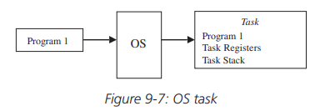
Cont’d
Unitasking OSes typically don’t require as complex a task management facility as a multitasking OS
In a multitasking environment, the added complexity of allowing multiple existing tasks requires that each process remain independent of the others and not affect any other without the specific programming to do so
This multitasking model provides each process with more security, which is not needed in a unitasking environment
Multitasking can actually provide a more organized way for a complex embedded system to function.
In a multitasking environment, system activities are divided up into simpler, separate components, or the same activities can be running in multiple processes simultaneously

Slide 13
Cont’d
Some multitasking OSes also provide threads (lightweight processes) as an additional, alternative means for encapsulating an instance of a program
Threads are created within the context of a task (meaning a thread is bound to a task), and, depending on the OS, the task can own one or more threads
A thread is a sequential execution stream within its task
Unlike tasks, which have their own independent memory spaces that are inaccessible to other tasks, threads of a task share the same resources (working directories, files, I/O devices, global data, address space, program code), but have their own PCs, stack, and scheduling information (PC, SP, stack, registers, etc.) to allow for the instructions they are executing to be scheduled independently
Since threads are created within the context of the same task and can share the same memory space, they can allow for simpler communication and coordination relative to tasks
This is because a task can contain at least one thread executing one program in one address space, or can contain many threads executing different portions of one program in one address space, needing no intertask communication mechanisms

Slide 14
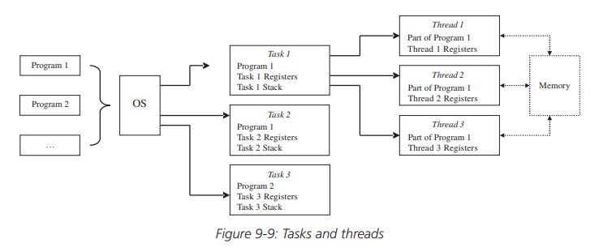
Cont’d
Also, in the case of shared resources, multiple threads are typically less expensive than creating multiple tasks to do the same work

Slide 15
Cont’d
Programmers define a separate task (or thread) for each of the system’s distinct activities to simplify all the actions of that activity into a single stream of events, rather than a complex set of overlapping events
However, it is generally left up to the programmer as to how many tasks are used to represent a system’s activity and, if threads are available, if and how they are used within the context of tasks
DOS-C is an example of a unitasking embedded OS, whereas vxWorks (Wind River), embedded Linux (Timesys), and Jbed (Esmertec) are examples of multitasking Oses

Slide 16
Cont’d
Jbed provides six different types of tasks that run alongside threads:
One shot Timer Task: which is a task that is run only once,
Periodic Timer Task: a task that is run after a particular set time interval,
Harmonic Event Task: a task that runs alongside a periodic timer task,
Join Event Task: a task that is set to run when an associated task completes,
Interrupt Event Task: a task that is run when a hardware interrupt occurs, and
User Event Task: a task that is explicitly triggered by another task

Slide 17
Multitasking and Process Management
Multitasking OSes require an additional mechanism over unitasking OSes to manage and synchronize tasks that can exist simultaneously
This is because, even when an OS allows multiple tasks to coexist, one master processor on an embedded board can only execute one task or thread at any given time
As a result, multitasking embedded OSes must find some way of allocating each task a certain amount of time to use the master CPU, and switching the master processor between the various tasks
It is by accomplishing this through task implementation, scheduling, synchronization, and inter-task communication mechanisms that an OS successfully gives the illusion of a single processor simultaneously running multiple tasks

Slide 18
Process Implementation
In multitasking embedded OSes, tasks are structured as a hierarchy of parent and child tasks, and when an embedded kernel starts up only one task exists
It is from this first task that all others are created
Task creation in embedded OSes is primarily based upon two models:
fork/exec: which derived from the IEEE /ISO POSIX 1003.1 standard
Spawn: which is derived from fork/exec Since the spawn model is based upon the fork/exec model, the methods of creating tasks under both models are similar
All tasks create their child tasks through fork/exec or spawn system calls
After the system call, the OS gains control and creates the Task Control Block (TCB), also referred to as a Process Control Block (PCB)

Slide 19
Cont’d
PCB contains OS control information, such as task ID, task state, task priority, and error status, and CPU context information, such as registers, for that particular task
At this point, memory is allocated for the new child task, including for its TCB, any parameters passed with the system call, and the code to be executed by the child task
After the task is set up to run, the system call returns and the OS releases control back to the main program
The main difference between the fork/exec and spawn models is how memory is allocated for the new child task
Under the fork/exec model, the “fork” call creates a copy of the parent task’s memory space in what is allocated for the child task, thus allowing the child task to inherit various properties, such as program code and variables, from the parent task
Because the parent task’s entire memory space is duplicated for the child task, two copies of the parent task’s program code are in memory, one for the parent, and one belonging to the child
The “exec” call is used to explicitly remove from the child task’s memory space any references to the parent’s program and sets the new program code belonging to the child task to run

Slide 20

Embedded Linux and fork/exec
In embedded Linux, all process creation is based upon the fork/exec model:
In Linux, a new “child” process can be created with the fork system call (shown above),
which creates an almost identical copy of the parent process
What differentiates the parent task from the child is the process ID—the process ID of the child process is returned to the parent, whereas a value of “0” is what the child process believes its process ID to be
The exec function call can then be used to switch to the child’s program code

Slide 21
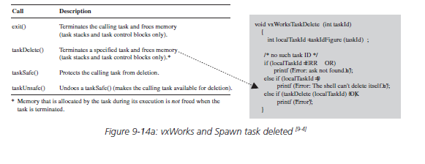
Cont’d
Tasks can terminate for a number of different reasons, such as normal completion, hardware problems such as lack of memory, and software problems such as invalid instructions
After a task has been terminated, it must be removed from the system so that it doesn’t waste resources, or even keep the system in limbo
In deleting tasks, an OS deallocates any memory allocated for the task (TCBs, variables, executed code, etc.)
In the case of a parent task being deleted, all related child tasks are also deleted or moved under another parent, and any share system resources are released

Slide 22
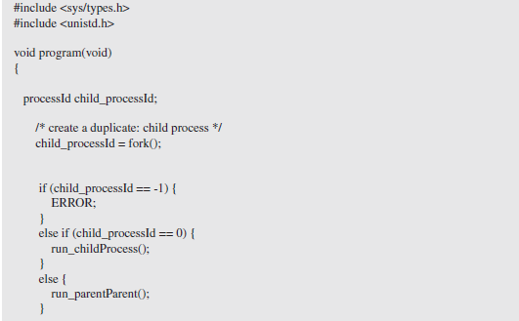
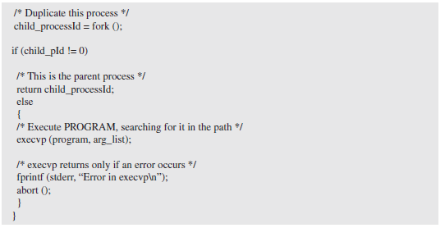
Cont’d

Slide 23
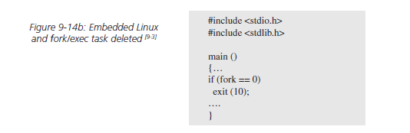
Cont’d
When a task is deleted in vxWorks, other tasks are not notified, and any resources, such as memory allocated to the task are not freed it is the responsibility of the programmer to manage the deletion of tasks using the subroutines below
In Linux, processes are deleted with the void exit(int status) system call, which deletes the process and removes any kernel references to process (updates flags, removes processes from queues, releases data structures, updates parent-child relationships, etc.)
Under Linux, child processes of a deleted process become children of the main init parent process

Slide 24
Cont’d
Because Jbed is based upon the Java model, a garbage collector is responsible for deleting a task and removing any unused code from memory once the task has stopped running
Jbed uses a non-blocking mark-and-sweep garbage collection algorithm which marks all objects still being used by the system and deletes (sweeps) all unmarked objects in memory
In addition to creating and deleting tasks, an OS typically provides the ability to suspend a task (meaning temporarily blocking a task from executing) and resume a task (meaning any blocking of the task’s ability to execute is removed). These two additional functions are provided by the OS to support task states
A task’s state is the activity (if any) that is going on with that task once it has been created, but has not been deleted

Slide 25
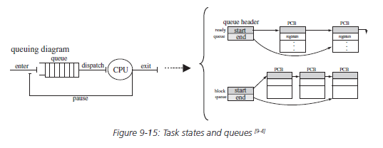
Cont’d
OSes usually define a task as being in one of three states:
Ready: The process is ready to be executed at any time, but is waiting for permission to use the CPU
Running: The process has been given permission to use the CPU, and can execute
Blocked or Waiting: The process is waiting for some external event to occur before it can be “ready” to “run”
OSes usually implement separate READY and BLOCK/WAITING “queues” containing tasks (their TCBs) that are in the relative state
Only one task at any one time can be in the RUNNING state, so no queue is needed for tasks in the RUNNING state

Slide 26
Cont’d
Based upon these three states (Ready, Blocked, and Running), most OSes have some process state transition model similar to the state diagram
In this diagram, the “New” state indicates a task that has been created, the “Exit” state is a task that has terminated (suspended or stopped running)
The other three states are defined above (Ready, Running, and Blocked)
The state transitions are:
New -> Ready: where a task has entered the ready queue and can be scheduled for running
Ready -> Running : based on the kernel’s scheduling algorithm, the task has been selected to run
Running -> Ready: the task has finished its turn with the CPU, and is returned to the ready queue for the next time around

Slide 27
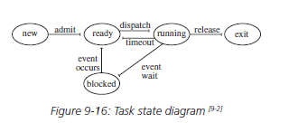
Cont’d
Running -> Blocked: some event has occurred to move the task into the blocked queue, not to run until the event has occurred or been resolved,
Blocked -> Ready: whatever blocked task was waiting for has occurred, and task is moved back to ready queue
When a task is moved from one of the queues (READY or BLOCKED/WAITING) into the RUNNING state, it is called a context switch

Slide 28
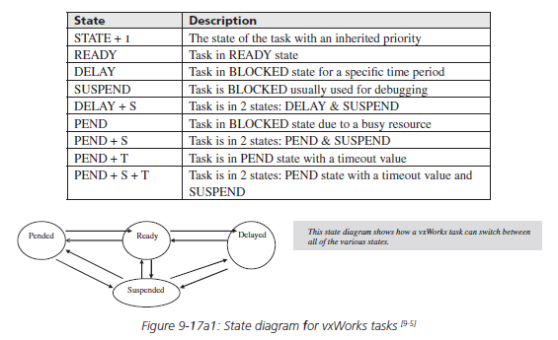
Cont’d
Other than the RUNNING state, VxWorks implements nine variations of the READY and BLOCKED/WAITING states, as shown in the following table and state diagram
Under vxWorks, separate ready, pending, and delay state queues exist to store the TCB information of a task that is within that respective state

Slide 29
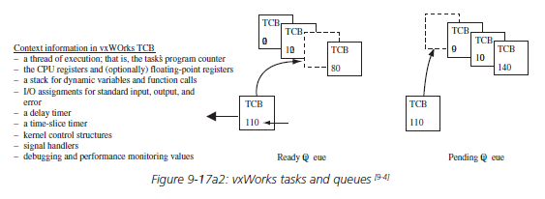
Cont’d
A task’s TCB is modified and is moved from queue to queue when a context switch occurs
When the Wind kernel context switches between two tasks, the information of the task currently running is saved in its TCB, while the TCB information of the new task to be executed is loaded for the CPU to begin executing
The Wind kernel contains two types of context switches:
Synchronous
Asynchronous
Synchronous, which occurs when the running task blocks itself (through pending, delaying, or suspending), and
Asynchronous, which occurs when the running task is blocked due to an external interrupt

Slide 30
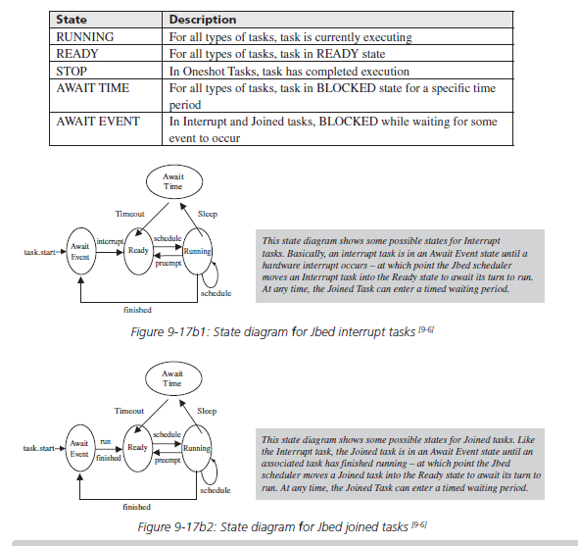
Cont’d
Jbed kernel and states
Jbed also uses separate queues to hold the task objects that are in the various states

Slide 31
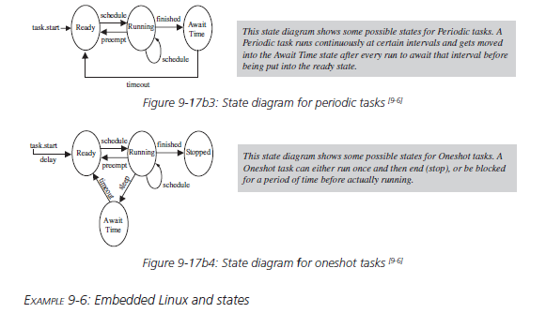
Cont’d

Slide 32
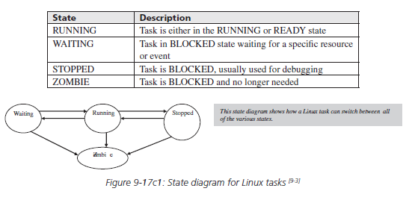
Cont’d
Embedded Linux and states
In Linux, RUNNING combines the traditional READY and RUNNING states, while there are three variations of the BLOCKED state
Under Linux, a process’s context information is saved in a PCB called the task_struct
In Linux there are separate queues that contain the task_struct (PCB) information for the process with that respective state

Slide 33
Process Scheduling
In a multitasking system, a mechanism within an OS, called a scheduler is responsible for determining the order and the duration of tasks to run on the CPU
The scheduler selects which tasks will be in what states (ready, running, or blocked), as well as loading and saving the TCB information for each task
On some OSes the same scheduler allocates the CPU to a process that is loaded into memory and ready to run, while in other OSes a dispatcher (a separate scheduler) is responsible for the actual allocation of the CPU to the process
There are many scheduling algorithms implemented in embedded OSes, and every design has its strengths and tradeoffs
The key factors that impact the effectiveness and performance of a scheduling algorithm include its response time (time for scheduler to make the context switch to a ready task and includes waiting time of task in ready queue), turnaround time (the time it takes for a process to complete running), overhead (the time and data needed to determine which tasks will run next), and fairness (what are the determining factors as to which processes get to run)

Slide 34
Cont’d
A scheduler needs to balance utilizing the system’s resources—keeping the CPU, I/O, as busy as possible—with task throughput, processing as many tasks as possible in a given amount of time
Especially in the case of fairness, the scheduler has to ensure that task starvation, where a task never gets to run, doesn’t occur when trying to achieve a maximum task throughput
In the embedded OS market, scheduling algorithms implemented in embedded OSes typically fall under two approaches:
Non-preemptive scheduling
Preemptive scheduling
Under non-preemptive scheduling, tasks are given control of the master CPU until they have finished execution, regardless of the length of time or the importance of the other tasks that are waiting

Slide 35
Cont’d
Scheduling algorithms based upon the non-preemptive approach include:
First-Come-First-Serve (FCFS)/ Run-To-Completion
Shortest Process Next (SPN)/Run-To-Completion
Round Robin/FIFO (First In, First Out) Scheduling
Priority (Preemptive) Scheduling
EDF (Earliest Deadline First)/Clock Driven Scheduling
First-Come-First-Serve (FCFS)/ Run-To-Completion:
Where tasks in the READY queue are executed in the order they entered the queue, and where these tasks are run until completion when they are READY to be run
Here, non preemptive means there is no BLOCKED queue in an FCFS scheduling design

Slide 36
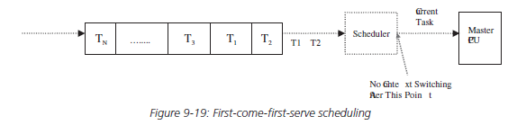
Cont’d
The response time of a FCFS algorithm is typically slower than other algorithms (i.e., especially if longer processes are in front of the queue requiring that other processes wait their turn), which then becomes a fairness issue since short processes at the end of the queue get penalized for the longer ones in front
With this design, however, starvation is not possible
Shortest Process Next (SPN)/Run-To-Completion:
Where tasks in the READY queue are executed in the order in which the tasks with the shortest execution time are executed first
The SPN algorithm has faster response times for shorter processes

Slide 37
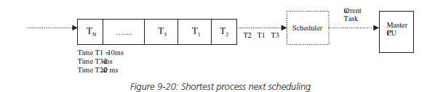
Cont’d
However, then the longer processes are penalized by having to wait until all the shorter processes in the queue have run
In this scenario, starvation can occur to longer processes if the ready queue is continually
filled with shorter processes
The overhead is higher than that of FCFS, since the calculation and storing of run times for the processes in the ready queue must occur

Slide 38
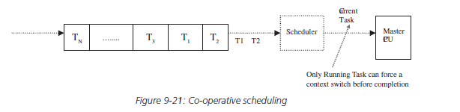
Cont’d
Co-operative, where the tasks themselves run until they tell the OS when they can be context switched (i.e., for I/O, etc.)
This algorithm can be implemented with the FCFS or SPN algorithms, rather than the run-to-completion scenario, but starvation could still occur with SPN if shorter processes were designed not to “cooperate,”
Non-preemptive algorithms can be riskier to support since an assumption must be made that no one task will execute in an infinite loop, shutting out all other tasks from the master CPU
However, OSes that support non-preemptive algorithms don’t force a context-switch before a task is ready, and the overhead of saving and restoration of accurate task information when switching between tasks that have not finished execution is only an issue if the non-preemptive scheduler implements a co-operative scheduling mechanism

Slide 39
Cont’d
In preemptive scheduling, on the other hand, the OS forces a context-switch on a task, whether or not a running task has completed executing or is cooperating with the context switch
Common scheduling algorithms based upon the preemptive approach include:
Round Robin/FIFO (First In, First Out) Scheduling
The Round Robin/FIFO algorithm implements a FIFO queue that stores ready processes (processes ready to be executed)
Processes are added to the queue at the end of the queue, and are retrieved to be run from the start of the queue
In the FIFO system, all processes are treated equally regardless of their workload or interactivity.
This is mainly due to the possibility of a single process maintaining control of the processor, never blocking to allow other processes to execute
Under round-robin scheduling, each process in the FIFO queue is allocated an equal time slice (the duration each process has to run), where an interrupt is generated at the end of each of these intervals to start the pre-emption process

Slide 40
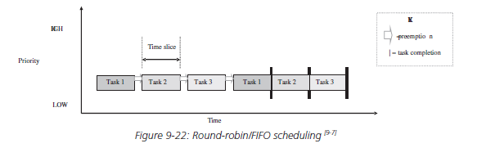
Cont’d
The scheduler then takes turns rotating among the processes in the FIFO queue and executing the processes consecutively, starting at the beginning of the queue
New processes are added to the end of the FIFO queue, and if a process that is currently running isn’t finished executing by the end of its allocated time slice, it is preempted and returned to the back of the queue to complete executing the next time its turn comes around
If a process finishes running before the end of its allocated time slice, the process voluntarily releases the processor, and the scheduler then assigns the next process of the FIFO queue to the processor

Slide 41
Cont’d
While Round Robin/FIFO scheduling ensures the equal treatment of processes, drawbacks surface when various processes have heavier workloads and are constantly preempted, thus creating more context switching overhead
Another issue occurs when processes in the queue are interacting with other processes (such as when waiting for the completion of another process for data), and are continuously preempted from completing any work until the other process of the queue has finished its run
The throughput depends on the time slice
If the time slice is too small, then there are many context switches, while too large a time slice isn’t much different from a non-preemptive approach, like FCFS
Starvation is not possible with the round-robin implementation

Slide 42
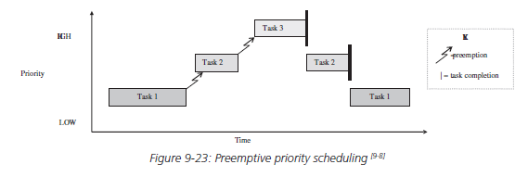
Cont’d
Priority (Preemptive) Scheduling
The priority preemptive scheduling algorithm differentiates between processes based upon their relative importance to each other and the system
Every process is assigned a priority, which acts as an indicator of orders of precedence within the system
The processes with the highest priority always preempt lower priority processes when they want to run, meaning a running task can be forced to block by the scheduler if a higher priority task becomes ready to run
Three tasks (1, 2, 3—where task 1 is the lowest priority task and task 3 is the highest), and task 3 preempts task 2, and task 2 preempts task 1

Slide 43
Cont’d
While this scheduling method resolves some of the problems associated with round robin/ FIFO scheduling in dealing with processes that interact or have varying workloads, new problems can arise in priority scheduling including:
Process starvation
Priority inversion
Process starvation: where a continuous stream of high priority processes keep lower priority processes from ever running
Typically resolved by aging lower priority processes (as these processes spend more time on queue, increase their priority levels)
Priority inversion: where higher priority processes may be blocked waiting for lower priority processes to execute, and processes with priorities in between have a higher priority in running, thus both the lower priority as well as higher priority processes don’t run

Slide 44


Cont’d
how to determine the priorities of various processes
Typically, the more important the task, the higher the priority it should be assigned
For tasks that are equally important, one technique that can be used to assign task priorities is the Rate Monotonic Scheduling (RMS) scheme, in which tasks are assigned a priority based upon how often they execute within the system
The premise behind this model is that, given a preemptive scheduler and a set of tasks that are completely independent (no shared data or resources) and are run periodically (meaning run at regular time intervals), the more often a task is executed within this set, the higher its priority should be
The RMS Theorem says that if the above assumptions are met for a scheduler and a set of “n” tasks, all timing deadlines will be met if the inequality

Slide 45
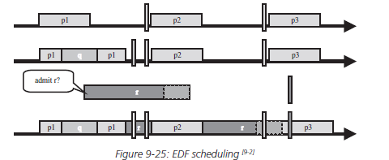
Cont’d
EDF (Earliest Deadline First)/Clock Driven Scheduling:
EDF/Clock Driven algorithm schedules priorities to processes according to three parameters:
Frequency (number of times process is run),
Deadline (when processes execution needs to be completed), and
Duration (time it takes to execute the process)
While the EDF algorithm allows for timing constraints to be verified and enforced (basically guaranteed deadlines for all tasks), the difficulty is defining an exact duration for various processes
Usually, an average estimate is the best that can be done for each process

Slide 46
Cont’d
Preemptive Scheduling and the Real-Time Operating System (RTOS):
One of the biggest differentiators between the scheduling algorithms implemented within embedded operating systems is whether the algorithm guarantees its tasks will meet execution time deadlines
If tasks always meet their deadlines, and related execution times are predictable (deterministic), the OS is referred to as a Real-Time Operating System (RTOS)
Preemptive scheduling must be one of the algorithms implemented within RTOS schedulers, since tasks with real-time requirements have to be allowed to preempt other tasks
RTOS schedulers also make use of their own array of timers, ultimately based upon the system clock, to manage and meet their hard deadlines
Whether an RTOS or a non real-time OS in terms of scheduling, all will vary in their implemented scheduling schemes
For example, vxWorks (Wind River) is a priority-based and round-robin scheme, Jbed (Esmertec) is an EDF scheme, and Linux (Timesys) is a priority- based scheme

Slide 47
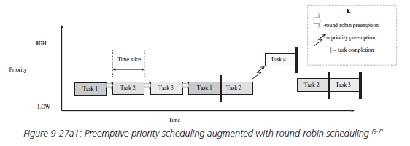
Cont’d
vxWorks scheduling:
The Wind scheduler is based upon both preemptive priority and round-robin real-time scheduling algorithms
Round-robin scheduling can be teamed with preemptive priority scheduling to allow for tasks of the same priority to share the master processor, as well as allow higher priority tasks to preempt for the CPU
Without round-robin scheduling, tasks of equal priority in vxWorks would never preempt each other, which can be a problem if a programmer designs one of these tasks to run in an infinite loop
However, the preemptive priority scheduling allows vxWorks its real-time capabilities, since tasks can be programmed never to miss a deadline by giving them the higher priorities to preempt all other tasks

Slide 48
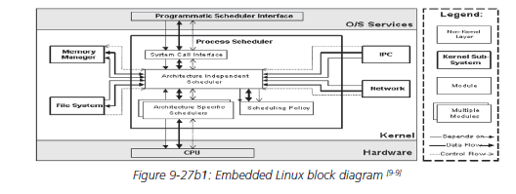
Cont’d
TimeSys embedded Linux priority based scheduling:
The embedded Linux kernel has a scheduler that is made up of four modules:
System call interface module, which acts as the interface between user processes and any functionality explicitly exported by the kernel
Scheduling policy module, which determines which processes have access to the CPU
Architecture specific scheduler module, which is an abstraction layer that interfaces with the hardware (i.e., communicating with CPU and the memory manager to suspend or resume processes)
Architecture independent scheduler module, which is an abstraction layer that interfaces between the scheduling policy module and the architecture specific module

Slide 49
Cont’d
The scheduling policy module implements a “priority-based” scheduling algorithm
While most Linux kernels and their derivatives (2.2/2.4) are non-preemptable, have no rescheduling, and are not real-time, Timesys’ Linux scheduler is priority-based, but has been modified to allow for real-time capabilities
Timesys has modified the traditional Linux’s standard software timers, which are too coarsely grained to be suitable for use in most real-time applications because they rely on the kernel’s jiffy timer, and implements high-resolution clocks and timers based on a hardware timer
The scheduler maintains a table listing all of the tasks within the entire system and any state information associated with the tasks
Under Linux, the total number of tasks allowed is only limited to the size of physical memory available
A dynamically allocated linked list of a task structure, whose fields that are relevant to scheduling are highlighted represents all tasks

Slide 50
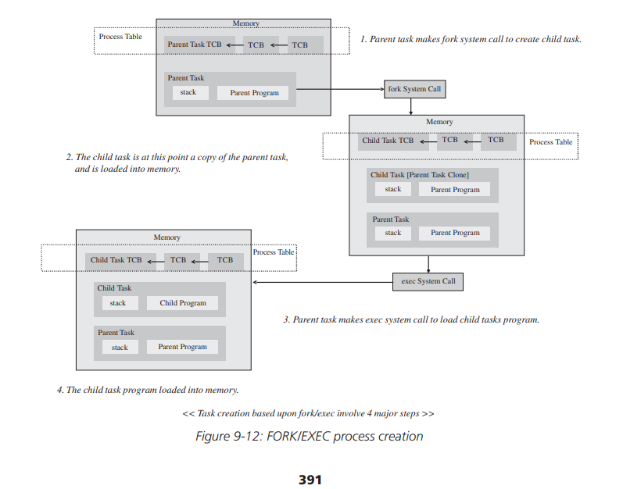
Cont’d

Slide 51
Cont’d
The spawn model, on the other hand, creates an entirely new address space for the child task
The spawn system call allows for the new program and arguments to be defined for the child task
This allows for the child task’s program to be loaded and executed immediately at the time of its creation
Both process creation models have their strengths and drawbacks
Under the spawn approach, there are no duplicate memory spaces to be created and destroyed, and then new space allocated, as is the case with the fork/exec model
The advantages of the fork/exec model, however, include the efficiency gained by the child task inheriting properties from the parent task, and then having the flexibility to change the child task’s environment afterwards

Slide 52
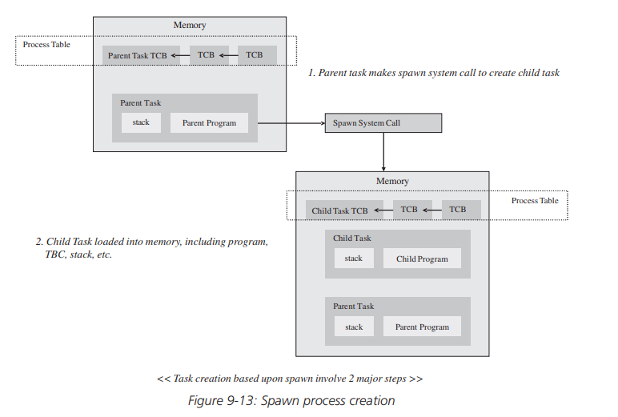
Cont’d

Slide 53
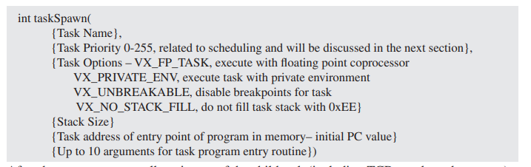
Cont’d
The two major steps of spawn task creation form the basis of creating tasks in VxWorks:
Creating a task in vxWorks
The vxWorks system call “taskSpawn” is based upon the POSIX spawn model, and it is what creates, initializes, and activates a new (child) task
After the spawn system call, an image of the child task (including TCB, stack, and program) is allocated into memory
Pseudocode example of task creation in the vxWorks RTOS where a parent task “spawns” a child task software timer

Slide 54
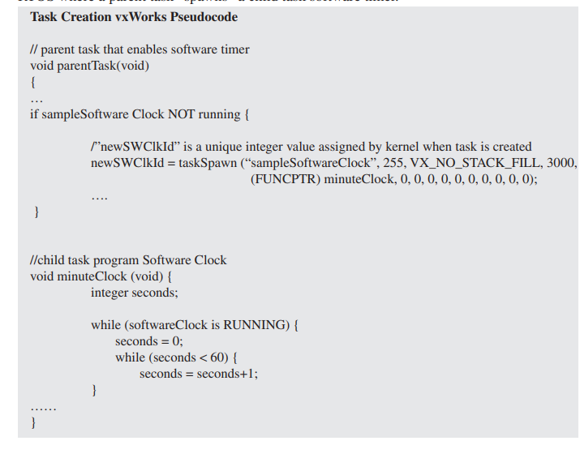
Cont’d

Slide 55
Intertask Communication and Synchronization
Different tasks in an embedded system typically must share the same hardware and software resources, or may rely on each other in order to function correctly
For these reasons, embedded OSes provide different mechanisms that allow for tasks in a multitasking system to intercommunicate and synchronize their behavior so as to coordinate their functions, avoid problems, and allow tasks to run simultaneously in harmony
Embedded OSes with multiple intercommunicating processes commonly implement interprocess communication (IPC) and synchronization algorithms based upon one or some combination of memory sharing, message passing, and signaling mechanisms
With the shared data model, processes communicate via access to shared areas of memory in which variables modified by one process are accessible to all processes

Slide 56
Cont’d
While accessing shared data as a means to communicate is a simple approach, the major issue of race conditions can arise
A race condition occurs when a process that is accessing shared variables is preempted before completing a modification access, thus affecting the integrity of shared variables
To counter this issue, portions of processes that access shared data, called critical sections, can be earmarked for mutual exclusion (or Mutex for short)
Mutex mechanisms allow shared memory to be locked up by the process accessing it, giving that process exclusive access to shared data
Various mutual exclusion mechanisms can be implemented not only for coordinating access to shared memory, but for coordinating access to other shared system resources as well

Slide 57
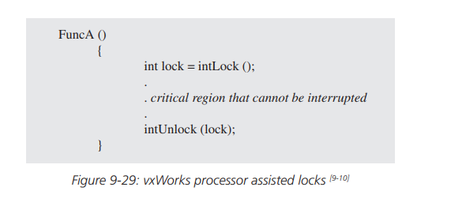
Cont’d
Mutual exclusion techniques for synchronizing tasks that wish to concurrently access shared data can include:
Processor assisted locks for tasks accessing shared data that are scheduled such that no other tasks can preempt them; the only other mechanisms that could force a context switch are interrupts
Disabling interrupts while executing code in the critical section would avoid a race condition scenario if the interrupt handlers access the same data
VxWorks provides an interrupt locking and unlocking function for users to implement in tasks

Slide 58
Cont’d
Another possible processor-assisted lock is the “test-and-set-instruction” mechanism (also referred to as the condition variable scheme)
Under this mechanism, the setting and testing of a register flag (condition) is an atomic function, a process that cannot be interrupted, and this flag is tested by any process that wants to access a critical section
In short, both the interrupt disabling and the condition variable type of locking schemes guarantee a process exclusive access to memory, where nothing can preempt the access to shared data and the system cannot respond to any other event for the duration of the access
Semaphores, which can be used to lock access to shared memory (mutual exclusion), and also can be used to coordinate running processes with outside events (synchronization)
The semaphore functions are atomic functions, and are usually invoked through system calls by the process

Slide 59
Cont’d
VxWorks defines three types of semaphores:
Binary semaphores
Mutual Exclusion semaphores
Counting semaphores
Binary semaphores are binary (0 or 1) flags that can be set to be available or unavailable. Only the associated resource is affected by the mutual exclusion when a binary semaphore is used as a mutual exclusion mechanism (whereas processor assisted locks, for instance, can affect other unrelated resources within the system)
A binary semaphore is initially set = 1 (full) to show the resource is available. Tasks check the binary semaphore of a resource when wanting access, and if available, then take the associated
Semaphore when accessing a resource (setting the binary semaphore = 0), and then give it back when finishing with a resource (setting the binary semaphore = 1)

Slide 60
Cont’d
When a binary semaphore is used for task synchronization, it is initially set equal to 0 (empty), because it acts as an event other tasks are waiting for
Other tasks that need to run in a particular sequence then wait (block) for the binary semaphore to be equal to 1 (until the event occurs) to take the semaphore from the original task and set it back to 0
The vxWorks pseudocode example below demonstrates how binary semaphores can be used in vxWorks for task synchronization
Mutual Exclusion semaphores are binary semaphores that can only be used for mutual exclusion issues that can arise within the vxWorks scheduling model, such as: priority inversion, deletion safety (insuring that tasks that are accessing a critical section and blocking other tasks aren’t unexpectedly deleted), and recursive access to resources
Below is a pseudocode example of a mutual exclusion semaphore used recursively by a task’s subroutines

Slide 61
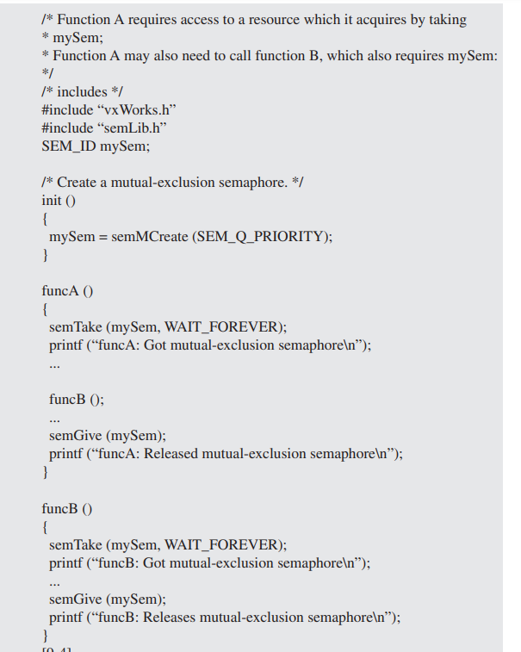
Cont’d

Slide 62
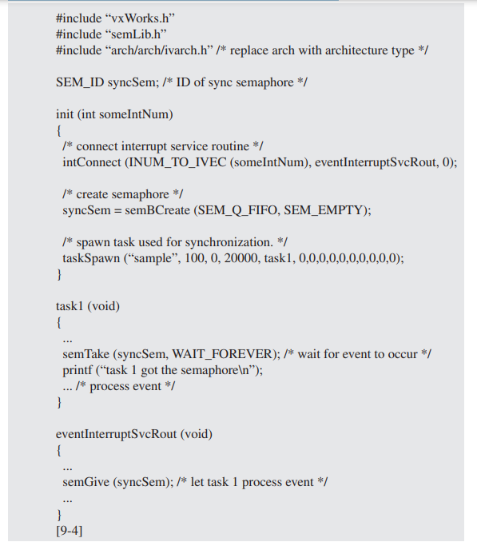
Cont’d

Slide 63
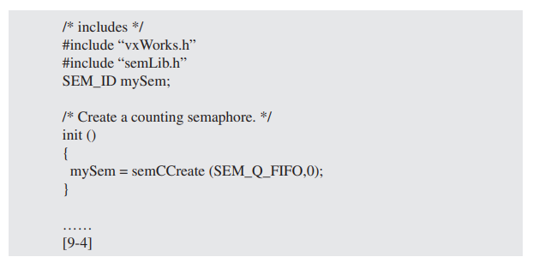
Cont’d
Counting semaphores are positive integer counters with two related functions: incrementing and decrementing
Counting semaphores are typically used to manage multiple copies of resources
Tasks that need access to resources decrement the value of the semaphore, when tasks relinquish a resource, the value of the semaphore is incremented
When the semaphore reaches a value of “0”, any task waiting for the related access is blocked until another task gives back the semaphore

Slide 64
Cont’d
On a final note, with mutual exclusion algorithms, only one process can have access to shared memory at any one time, basically having a lock on the memory accesses
If more than one process blocks waiting for their turn to access shared memory, and relying on data from each other, a deadlock can occur (such as priority inversion in priority based scheduling)
Thus, embedded OSes have to be able to provide deadlock-avoidance mechanisms as well as deadlock-recovery mechanisms
In vxWorks, semaphores are used to avoid and prevent deadlocks
Intertask communication via message passing is an algorithm in which messages (made up of data bits) are sent via message queues between processes
The OS defines the protocols for process addressing and authentication to ensure that messages are delivered to processes reliably, as well as the number of messages that can go into a queue and the message sizes

Slide 65
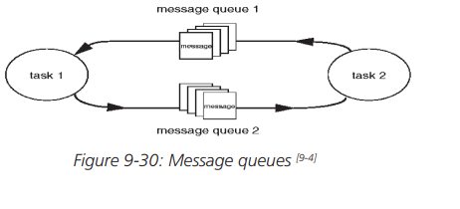
Cont’d
Under this scheme, OS tasks send messages to a message queue, or receive messages from a queue to communicate
Microkernel-based OSes typically use the message passing scheme as their main synchronization mechanism

Slide 66
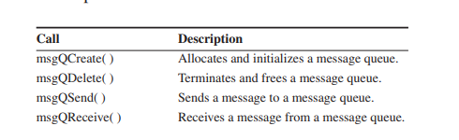
Cont’d
Message passing in VxWorks:
VxWorks allows for intertask communication via message passing queues to store data transmitted between different tasks or an ISR
VxWorks provides the programmer four system calls to allow for the development of this scheme:

Slide 67
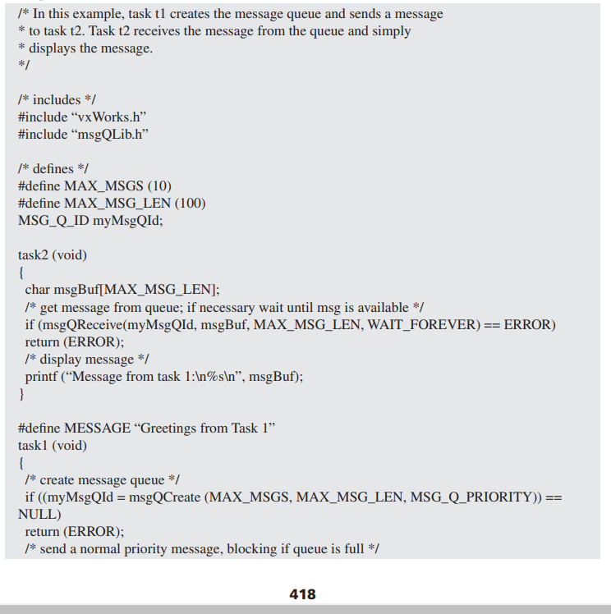
Cont’d

Slide 68
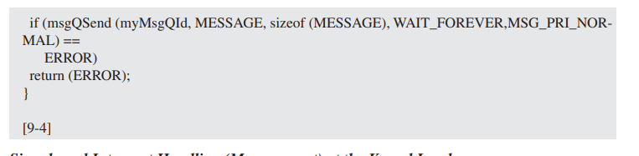
Cont’d

Slide 69
Signals and Interrupt Handling (Management) at the Kernel Level
Signals are indicators to a task that an asynchronous event has been generated by some external event (other processes, hardware on the board, timers, etc.) or some internal event (problems with the instructions being executed, etc.)
When a task receives a signal, it suspends executing the current instruction stream and context switches to a signal handler (another set of instructions)
The signal handler is typically executed within the task’s context (stack) and runs in the place of the signaled task when it is the signaled task’s turn to be scheduled to execute
Signals are typically used for interrupt handling in an OS, because of their asynchronous nature
When a signal is raised, a resource’s availability is unpredictable

Slide 70
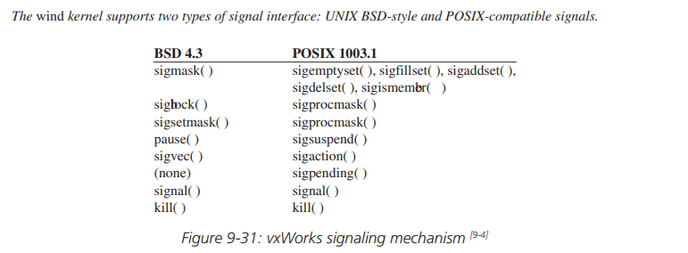
Cont’d

Slide 71
Cont’d
However, signals can be used for general intertask communication, but are implemented so that the possibility of a signal handler blocking or a deadlock occurring is avoided
The other inter-task communication mechanisms (shared memory, message queues, etc.), along with signals, can be used for ISR-to-Task level communication, as well
When signals are used as the OS abstraction for interrupts and the signal handling routine becomes analogous to an ISR, the OS manages the interrupt table, which contains the interrupt and information about its corresponding ISR, as well as provides a system call (subroutine) with parameters that that can be used by the programmer. At the same time, the OS protects the integrity of the interrupt table and ISRs, because this code is executed in kernel/supervisor mode.
The general process that occurs when a process receives a signal generated by an interrupt and an interrupt handler is called OS Interrupt routine

Slide 72
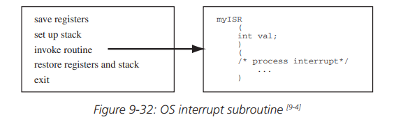
Cont’d
The architecture determines the interrupt model of an embedded system (that is, the number of interrupts and interrupt types)
The interrupt device drivers initialize and provide access to interrupts for higher layer of software
The OS then provides the signal inter-process communication mechanism to allow for its processes to work with interrupts, as well as can provide various interrupt subroutines that abstracts out the device driver
While all OSes have some sort of interrupt scheme, this will vary depending on the architecture they are running on, since architectures differ in their own interrupt schemes

Slide 73
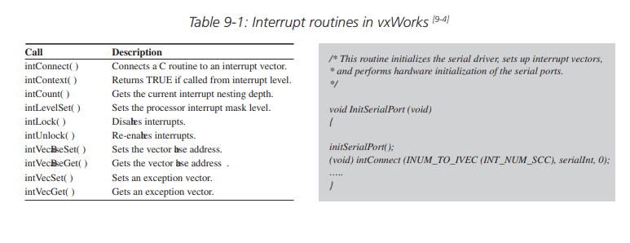
Cont’d
Interrupt handling in VxWorks
Except for architectures that do not allow for a separate interrupt stack (and thus the stack of the interrupted task is used), ISRs use the same interrupt stack, which is initialized and configured at system start-up, outside the context of the interrupting task
The interrupt routines provided in vxWorks, along with a pseudocode example of using one of these routines

Slide 74
Memory Management
A kernel manages program code within an embedded system via tasks
The kernel must also have some system of loading and executing tasks within the system, since the CPU only executes task code that is in cache or RAM
With multiple tasks sharing the same memory space, an OS needs a security system mechanism to protect task code from other independent tasks
Also, since an OS must reside in the same memory space as the tasks it is managing, the protection mechanism needs to include managing its own code in memory and protecting it from the task code it is managing
It is these functions, and more, that are the responsibility of the memory management components of an OS

Slide 75
Cont’d
In general, a kernel’s memory management responsibilities include:
Managing the mapping between logical (physical) memory and task memory references
Determining which processes to load into the available memory space
Allocating and deallocating of memory for processes that make up the system
Supporting memory allocation and deallocation of code requests (within a process) such as the C language “alloc” and “dealloc” functions, or specific buffer allocation and deallocation routines
Tracking the memory usage of system components
Ensuring cache coherency (for systems with cache)
Ensuring process memory protection

Slide 76
User Memory Space
Because multiple processes are sharing the same physical memory when being loaded into RAM for processing, there also must be some protection mechanism so processes cannot inadvertently affect each other when being swapped in and out of a single physical memory space
These issues are typically resolved by the operating system through memory “swapping,” where partitions of memory are swapped in and out of memory at run-time
The most common partitions of memory used in swapping are segments (fragmentation of processes from within) and pages (fragmentation of logical memory as a whole)
Segmentation and paging not only simplify the swapping—memory allocation and deallocation—of tasks in memory, but allow for code reuse and memory protection, as well as providing the foundation for virtual memory
Virtual memory is a mechanism managed by the OS to allow a device’s limited memory space to be shared by multiple competing “user” tasks, in essence enlarging the device’s actual physical memory space into a larger “virtual” memory space

Slide 77
Segmentation
A process encapsulates all the information that is involved in executing a program, including source code, stack, data, and so on
All of the different types of information within a process are divided into “logical” memory units of variable sizes, called segments
A segment is a set of logical addresses containing the same type of information
Segment addresses are logical addresses that start at 0, and are made up of a segment number, which indicates the base address of the segment, and a segment offset, which defines the actual physical memory address
Segments are independently protected, meaning they have assigned accessibility characteristics, such as shared (where other processes can access that segment), Read-Only, or Read/Write
Most OSes typically allow processes to have all or some combination of five types of information within segments:
Text (or code) segment,
Data segment,
bss (block started by symbol) segment
Stack segment,
The heap segment

Slide 78
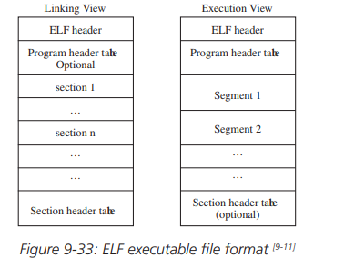
Cont’d

Slide 79
Cont’d
There are several executable file formats supported by embedded OSes, the most common including: v ELF (Executable and Linking Format):
UNIX-based, includes some combination of an ELF header, the program header table, the section header table, the ELF sections, and the ELF segments
Linux (Timesys) and vxWorks (WRS) are examples of OSes that support ELF
Class (Java Byte Code):
A class file describes one java class in detail in the form of a stream of 8-bit bytes (hence the name “byte code”)
Instead of segments, elements of the class file are called items
The Java class file format contains the class description, as well as, how that class is connected to other classes
The main components of a class file are a symbol table (with constants), declaration of fields, method implementations (code) and symbolic references (where other classes references are located)
The Jbed RTOS is an example that supports the Java Byte Code format

Slide 80
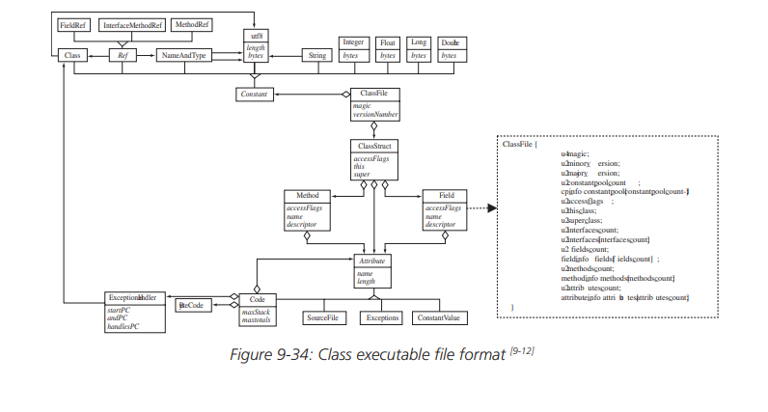
Cont’d

Slide 81
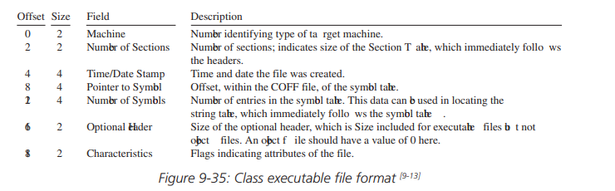
Cont’d
COFF (Common Object File Format):
A class file format which (among other things) defines an image file that contains file headers that include a file signature, COFF Header, an Optional Header, and also object files that contain only the COFF Header
WinCE[MS] is an example of an embedded OS that supports the COFF executable file format

Slide 82
Cont’d
The stack and heap segments, on the other hand, are not fixed at compile time, and can change in size at runtime and so are dynamic allocation components
A stack segment is a section of memory that is structured as a LIFO (last in, first out) queue, where data is “Pushed” onto the stack, or “Popped” off of the stack (push and pop are the only two operations associated with a stack)
Stacks are typically used as a simple and efficient method within a program for allocating and freeing memory for data that is predictable (i.e., local variables, parameter passing, etc.)
In a stack, all used and freed memory space is located consecutively within the memory space
However, since “push” and “pop” are the only two operations associated with a stack, a stack can be limited in its use

Slide 83
Cont’d
A heap segment is a section of memory that can be allocated in blocks at runtime, and is typically set up as a free linked-list of memory fragments
It is here that a kernel’s memory management facilities for allocating memory come into play to support the “malloc” C function (for example) or OS-specific buffer allocation functions
Typical memory allocation schemes include:
FF (first fit) algorithm, where the list is scanned from the beginning for the first “hole” that is large enough
NF (next fit) where the list is scanned from where the last search ended for the next “hole” that is large enough
BF (best fit) where the entire list is searched for the hole that best fits the new data
WF (worst fit) which is placing data in the largest available “hole”
QF (quick fit) where a list is kept of memory sizes and allocation is done from this inform

Slide 84
Cont’d
The buddy system, where blocks are allocated in sizes of powers of 2
When a block is deallocated, it is then merged with contiguous blocks
The method by which memory that is no longer needed within a heap is freed depends on the OS
Some OSes provide a garbage collector that automatically reclaims unused memory (garbage collection algorithms include generational, copying, and mark and sweep
Other OSes require that the programmer explicitly free memory through a system call (i.e., in support of the “free” C function)
With the latter technique, the programmer has to be aware of the potential problem of memory leaks, where memory is lost because it has been allocated but is no longer in use and has been forgotten, which is less likely to happen with a garbage collector
Another problem occurs when allocated and freed memory cause memory fragmentation, where available memory in the heap is spread out in a number of holes, making it more difficult to allocate memory of the required size

Slide 85
Cont’d
In this case, a memory compaction algorithm must be implemented if the allocation/de-allocation algorithms causes a lot of fragmentation
This problem can be demonstrated by examining garbage collection algorithms
The copying garbage collection algorithm works by copying referenced objects to a different part of memory, and then freeing up the original memory space
This algorithm uses a larger memory area to work, and usually cannot be interrupted during the copy (it blocks the systems)
However, it does ensure that what memory is used, is used efficiently by compacting objects in the new memory space

Slide 86
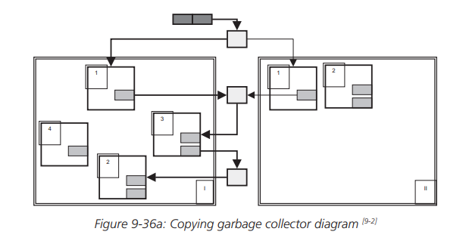
Cont’d

Slide 87
Cont’d
The mark and sweep garbage collection algorithm works by “marking” all objects that are used, and then “sweeping” (de-allocating) objects that are unmarked
This algorithm is usually nonblocking, so the system can interrupt the garbage collector to execute other functions when necessary
However, it doesn’t compact memory the way a Copying garbage collector would, leading to memory fragmentation with small, unusable holes possibly existing where deallocated objects used to exist
With a mark and sweep garbage collector, an additional memory compacting algorithm could be implemented making it a mark (sweep) and compact algorithm

Slide 88
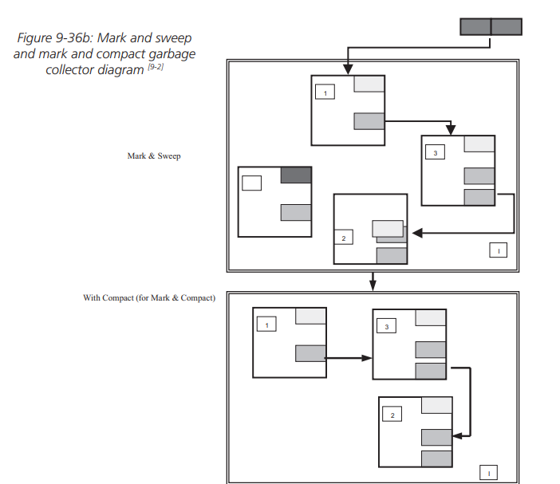
Cont’d

Slide 89
Cont’d
Finally, heaps are typically used by a program when allocation and deletion of variables are unpredictable (linked lists, complex structures, etc.)
However, heaps aren’t as simple or as efficient as stacks
As how memory in a heap is allocated and deallocated is typically affected by the programming language the OS is based upon, such as a C-based OS using “malloc” to allocate memory in a heap and “free” to deallocate memory or a Java-based OS having a garbage collector

Slide 90
Cont’d
vxWorks memory management and segmentation:
VxWorks tasks are made up of text, data, and bss static segments, as well as each task having its own stack
The vxWorks system call “taskSpawn” is based upon the POSIX spawn model, and is what creates, initializes, and activates a new (child) task
After the spawn system call, an image of the child task (including TCB, stack, and program) is allocated into memory
In the pseudocode below, the code itself is the text segment, data segments are any initialized variables, and the bss segments are the uninitialized variables (i.e., seconds,…)
In the taskSpawn system call, the task stack size is 3000 bytes, and is not filled with 0xEE because of the VX_NO_ STACK_FILL parameter in the system call

Slide 91
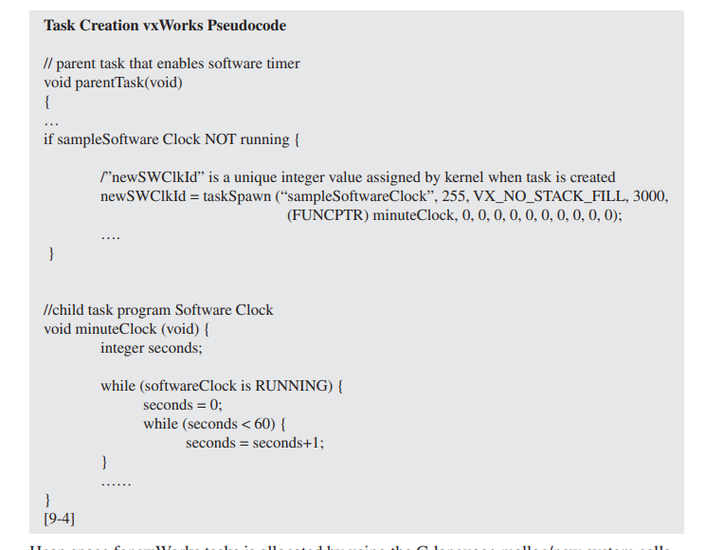
Cont’d

Slide 92
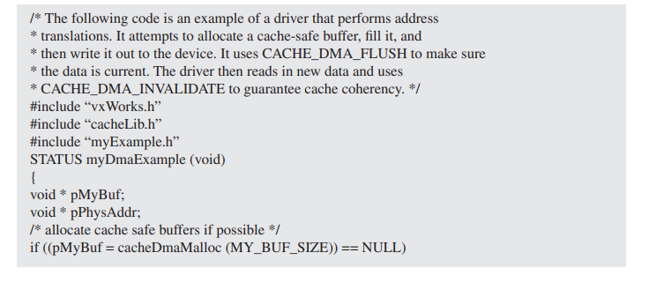
Cont’d
Heap space for vxWorks tasks is allocated by using the C-language malloc/new system calls to dynamically allocate memory
There is no garbage collector in vxWorks, so the programmer must deallocate memory manually via the free() system call

Slide 93
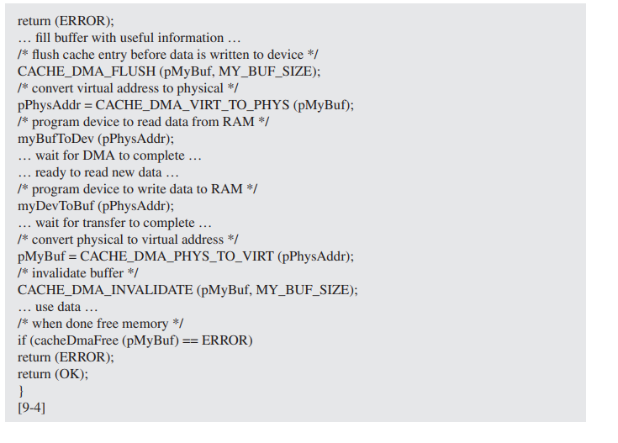
Cont’d

Slide 94
Paging and Virtual Memory
Either with or without segmentation, some OSes divide logical memory into some number of fixed-size partitions, called blocks, frames, pages or some combination of a few or all of these
For example, with OSes that divide memory into frames, the logical address is compromised of a frame number and offset
The user memory space can then, also, be divided into pages, where page sizes are typically equal to frame sizes
When a process is loaded in its entirety into memory (in the form of pages), its pages may not be located within a contiguous set of frames
Every process has an associated process table that tracks its pages, and each page’s corresponding frames in memory
The logical address spaces generated are unique for each process, even though multiple processes share the same physical memory space

Slide 95
Cont’d
Logical address spaces are typically made up of a page-frame number, which indicates the start of that page, and an offset of an actual memory location within that page
In essence, the logical address is the sum of the page number and the offset
An OS may start by prepaging, or loading the pages needed to get started, and then implementing the scheme of demand paging where processes have no pages in memory, and pages are only loaded into RAM when a page fault (an error occurring when attempting to access a page not in RAM) occurs
When a page fault occurs, the OS takes over and loads the needed page into memory, updates page tables, and then the instruction that triggered the page fault in the first place is re-executed
This scheme is based upon Knuth’s Locality of Reference theory, which estimates that 90% of a system’s time is spent on processing just 10% of code
Dividing up logical memory into pages aids the OS in more easily managing tasks being relocated in and out of various types of memory in the memory hierarchy, a process called swapping

Slide 96
Cont’d
Common page selection and replacement schemes to determine which pages are swapped include:
Optimal, using future reference time, swapping out pages that won’t be used in the near future
Least Recently Used (LRU), which swaps out pages that have been used the least recently
FIFO (First-In-First-Out), which as its name implies, swaps out the pages that are the oldest (regardless of how often it is accessed) in the system. While a simpler algorithm then LRU, FIFO is much less efficient
Not Recently Used (NRU), swaps out pages that were not used within a certain time period.
Second Chance, FIFO scheme with a reference bit, if “0” will be swapped out (a reference bit is set to “1” when access occurs, and reset to “0” after the check)
Clock Paging, pages replaced according to clock (how long they have been in memory), in clock order, if they haven’t been accessed (a reference bit is set to “1” when access occurs, and reset to “0” after the check

Slide 97
Cont’d
While every OS has its own swap algorithm, all are trying to reduce the possibility of thrashing, a situation in which a system’s resources are drained by the OS constantly swapping in and out data from memory
To avoid thrashing, a kernel may implement a working set model, which keeps a fixed number of pages of a process in memory at all times
Which pages (and the number of pages) that comprise this working set depends on the OS, but typically it is the pages accessed most recently
A kernel that wants to prepage a process also needs to have a working set defined for that process before the process’s pages are swapped into memory

Slide 98
Virtual Memory
Virtual memory is typically implemented via demand segmentation and/or demand paging (fragmentation of logical user memory as a whole) memory fragmentation techniques
When virtual memory is implemented via these “demand” techniques, it means that only the pages and/or segments that are currently in use are loaded into RAM
In a virtual memory system, the OS generates virtual addresses based on the logical addresses, and maintains tables for the sets of logical addresses into virtual addresses conversions
The OS (along with the hardware) then can end up managing more than one different address space for each process (the physical, logical, and virtual)
In short, the software being managed by the OS views memory as one continuous memory space, whereas the kernel actually manages memory as several fragmented pieces which can be segmented and paged, segmented and unpaged, unsegmented and paged, or unsegmented and unpaged

Slide 99

Cont’d

Slide 100
Kernel Memory Space
The kernel’s memory space is the portion of memory in which the kernel code is located, some of which is accessed via system calls by higher-level software processes, and is where the CPU executes this code from
Code located in the kernel memory space includes required IPC mechanisms, such as those for message passing queues
Another example is when tasks are creating some type of fork/exec or spawn system calls
After the task creation system call, the OS gains control and creates the Task Control Block (TCB), also referred to as a Process Control Block (PCB) in some OSes, within the kernel’s memory space that contains OS control information and CPU context information for that particular task
Ultimately, what is managed in the kernel memory space, as opposed to in the user space, is determined by the hardware, as well as the actual algorithms implemented within the OS kernel
As previously mentioned, software running in user mode can only access anything running in kernel mode via system calls. System calls are the higher-level (user mode) interfaces to the kernel’s subroutines (running in kernel mode)

Slide 101
Cont’d
Parameters associated with system calls that need to be passed between the OS and the system callee running in user mode are then passed via registers, a stack, or in the main memory heap
The types of system calls typically fall under the types of functions being supported by the OS, so they include file systems management (i.e., opening/modifying files), process management (i.e., starting/stopping processes), I/O communications, and so on
In short, where an OS running in kernel mode views what is running in user mode as processes, software running in user mode views and defines an OS by its system calls.

Slide 102
I/O and File System Management
Some embedded OSes provide memory management support for a temporary or permanent file system storage scheme on various memory devices, such as Flash, RAM, or hard disk
File systems are essentially a collection of files along with their management protocols
File system algorithms are middleware and/or application software that is mounted (installed) at some mount point (location) in the storage device
In relation to file systems, a kernel typically provides file system management mechanisms for, at the very least:
Mapping files onto secondary storage, Flash, or RAM (for instance)
Supporting the primitives for manipulating files and directories
File Definitions and Attributes: Naming Protocol, Types (i.e., executable, object, source, multimedia, etc.), Sizes, Access Protection (Read, Write, Execute, Append, Delete, etc.), Ownership, and so on
File Operations: Create, Delete, Read, Write, Open, Close, and so on
File Access Methods: Sequential, Direct, and so on
Directory Access, Creation and Deletion

Slide 103
Cont’d
OSes vary in terms of the primitives used for manipulating files (i.e., naming, data structures, file types, attributes, operations, etc.), what memory devices files can be mapped to, and what file systems are supported
Most OSes use their standard I/O interface between the file system and the memory device drivers
This allows for one or more file systems to operate in conjunction with the operating system
I/O Management in embedded OSes provides an additional abstraction layer (to higher level software) away from the system’s hardware and device drivers
An OS provides a uniform interface for I/O devices that perform a wide variety of functions via the available kernel system calls, providing protection to I/O devices since user processes can only access I/O via these system calls, and managing a fair and efficient I/O sharing scheme among the multiple processes

Slide 104
Cont’d
An OS also needs to manage synchronous and asynchronous communication coming from I/O to its processes, in essence be event-driven by responding to requests from both sides (the higher level processes and low-level hardware), and manage the data transfers
In order to accomplish these goals, an OS’s I/O management scheme is typically made up of a generic device-driver interface both to user processes and device drivers, as well as some type of buffer-caching mechanism
Device driver code controls a board’s I/O hardware
In order to manage I/O, an OS may require all device driver code to contain a specific set of functions, such as startup, shutdown, enable, disable, and so on
A kernel then manages I/O devices, and in some OSes file systems as well, as “black boxes” that are accessed by some set of generic APIs by higher-layer processes

Slide 105
Cont’d
OSes can vary widely in terms of what types of I/O APIs they provide to upper layers. For example, under Jbed, or any Java-based scheme, all resources (including I/O) are viewed and structured as objects
VxWorks, on the other hand, provides a communications mechanism, called pipes, for use with the vxWorks I/O subsystem
Under vxWorks, pipes are virtual I/O devices that include underlying message queue associated with that pipe
Via the pipe, I/O access is handled as either a stream of bytes (block access) or one byte at any given time (character access)
In some cases, I/O hardware may require the existence of OS buffers to manage data transmissions
Buffers can be necessary for I/O device management for a number of reasons
Mainly they are needed for the OS to be able to capture data transmitted via block access

Slide 106

Cont’d
The OS stores within buffers the stream of bytes being transmitted to and from an I/O device independent of whether one of its processes has initiated communication to the device
When performance is an issue, buffers are commonly stored in cache, rather than in slower main memory

Slide 107
OS Standards Example: POSIX (Portable Operating System Interface)
Standards may greatly impact the design of a system component and operating systems are no different
One of the key standards implemented in off-the-shelf embedded OSes today is portable operating system interface (POSIX)
POSIX is based upon the IEEE (1003.1-2001)
The Open Group (The Open Group Base Specifications Issue 6) set of standards that define a standard operating system interface and environment
POSIX provides OS-related standard APIs and definitions for process management, memory management, and I/O management functionality

Slide 108

Cont’d

Slide 109

Cont’d

Slide 110

Cont’d
Linux POSIX example:
Creating a Linux POSIX thread:
Here, threadId is a parameter for receiving the thread ID
The second argument is a thread attribute argument that supports a number of scheduling options (in this case NULL indicates the default settings will be used)
The third argument is the subroutine to be executed upon creation of the thread
The fourth argument is a pointer passed to the subroutine (i.e., pointing to memory reserved for the thread, anything required by the newly created thread to do its work etc)

Slide 111

Cont’d
vxWorks POSIX example:
Creating a POSIX thread in VxWorks
Here, threadId is a parameter for receiving the thread ID
The second argument is a thread attribute argument that supports a number of scheduling options (in this case NULL indicates the default settings will be used)
The third argument is the subroutine to be executed upon creation of the thread
The fourth argument is a pointer passed to the subroutine (i.e., pointing to memory reserved for the thread, anything required by the newly created thread to do its work, etc)

Slide 112
Cont’d
Essentially, the POSIX APIs allow for software that is written on one POSIX-compliant OS to be easily ported to another POSIX OS, since by definition the APIs for the various OS system calls must be identical and POSIX compliant
It is up to the individual OS vendors to determine how the internals of these functions are actually performed
This means that, given two different POSIX compliant OSes, both probably employ very different internal code for the same routines

Slide 113
OS Performance Guidelines
The two subsystems of an OS that typically impact OS performance the most, and differentiate the performance of one OS from another, are the memory management scheme and the scheduler
The performance of one virtual memory-swapping algorithm over another can be compared by the number of page faults they produce, given the same set of memory references that is, the same number of page frames assigned per process for the exact same process on both Oses
One algorithm can be further tested for performance by providing it with a variety of different memory references and noting the number of page faults for various number of page frames per process configurations
While the goal of a scheduling algorithm is to select processes to execute in a scheme that maximizes overall performance, the challenge OS schedulers face is that there are a number of performance indicators

Slide 114
Cont’d
The main performance indicators for scheduling algorithms include:
Throughput
Execution time
Wait time
Throughput:
The number of processes being executed by the CPU at any given time
At the OS scheduling level, an algorithm that allows for a significant number of larger processes to be executed before smaller processes runs the risk of having a lower throughput
In a SPN (shortest process next) scheme, the throughput may even vary on the same system depending on the size of processes being executed at the moment
Execution time: The average time it takes for a running process to execute (from start to finish). Here, the size of the process affects this indicator
However, at the scheduling level, an algorithm that allows for a process to be continually preempted allows for significantly longer execution times
In this case, given the same process, a comparison of a non-preemptable vs. preemptable scheduler could result in two very different execution times

Slide 115
Cont’d
Wait time:
The total amount of time a process must wait to run
Again this depends on whether the scheduling algorithm allows for larger processes to be executed before slower processes
Given a significant number of larger processes executed (for whatever reason), any subsequent processes would have higher wait times
This indicator is also dependent on what criteria determines which process is selected to run in the first place a process in one scheme may have a lower or higher wait time than if it is placed in a different scheduling scheme

Slide 116
OSes and Board Support Packages (BSPs)
The board support package (BSP) is an optional component provided by the OS provider, the main purpose of which is simply to provide an abstraction layer between the operating system and generic device drivers
A BSP allows for an OS to be more easily ported to a new hardware environment, because it acts as an integration point in the system of hardware dependent and hardware independent source code
A BSP provides subroutines to upper layers of software that can customize the hardware, and provide flexibility at compile time
Because these routines point to separately compiled device driver code from the rest of the system application software, BSPs provide run-time portability of generic device driver code
A BSP provides architecture-specific device driver configuration management, and an API for the OS higher layers of software) to access generic device drivers

Slide 117
Cont’d
A BSP is also responsible for managing the initialization of the device driver (hardware) and OS in the system
The device configuration management portion of a BSP involves architecture-specific device driver features, such as constraints of a processor’s available addressing modes, endianess, and interrupts (connecting ISRs to interrupt vector table, disabling/enabling, control registers) and so on
It is designed to provide the most flexibility in porting generic device drivers to a new architecture-based board, with its differing endianess, interrupt scheme, and other architecture-specific features

Slide 118

Cont’d

Slide 119
THANK YOU

